Slide 1




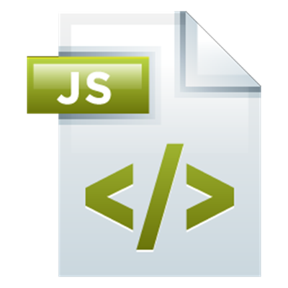
Control-Flow Logic in JS
Operators, Expressions, Statements, Conditional Statements, Loops
Control Flow
SoftUni Team
Technical Trainers
Software University
http://softuni.bg

Slide 2



Table of Contents
Operators, Expressions, Statements
Conditional Statements
if-else, switch-case
Loops
for, while, do-while, for-in, for-of

Slide 3
Have a Question?
sli.do #JSCORE

Slide 4
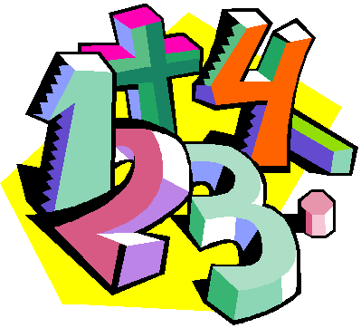
Operators and Expressions in JS
Arithmetic,
Logical, Comparison,
Assignment,
Others

Slide 5
Arithmetic Operators in JS
console.log(3 + 4 - 2); // 5 (add / subtract numbers)
console.log(3 * 2); // 6 (multiply numbers)
console.log(2 ** 10); // 1024 (exponential operator **)
console.log(5 / 2); // 2.5 (divide numbers)
console.log(5 / 0); // Infinity (divide by zero)
console.log(Infinity / Infinity); // NaN (wrong division)
console.log(Math.floor(7 / 3)); // 2 (integral division)
console.log(7 % 3); // 1 (remainder of division)
console.log(5.3 % 3); // 2.3 (remainder of division)
let a = 5; console.log(++a); // 6 (prefixed ++)
console.log(a++); // 6 (postfix ++)

Slide 6
Problem: Multiply Two Numbers
Write a JS function to multiply two numbers
Test this function in the judge system
function mult(num1, num2) {
let result = num1 * num2
return result
}
The judge sends the input as parameters, specified in the problem description
Invoke the above function to test it locally
mult(4, 2.5) // returns 10
Check your solution here: https://judge.softuni.bg/Contests/288

Slide 7


Problem: Boxes and Bottles
Write a JS function to calculate how many boxes will be needed to fit n bottles if each box fits k bottles
20
5
4
15
7
3
5
10
1
function boxesAndBottles(n, k) {
console.log(Math.ceil(n / k));
}
Check your solution here: https://judge.softuni.bg/Contests/288

Slide 8
Logical Operators in JS
The || operators returns the leftmost "true" value:
The && operators returns the leftmost "false" value:
let t = false || 0 || '' || 5 || 'hi' || true;
console.log(t); // 5
let val = true && 'yes' && 5 && null && false;
console.log(val); // null

Slide 9
Comparison Operators in JS
Comparison operators compare values
==, !=, <, >, >=, <=, ===, !==
The == means "equal after type conversion"
The === means "equal and of the same type"
var a = 5;
var b = 4;
console.log(a == b); // false
console.log(a != b); // true
console.log(a >= b); // true
console.log(a < "5.5"); // true
console.log(0 == ""); // true
console.log(0 == []); // true
console.log(0 === ""); // false
console.log(3 !== "3"); // true

Slide 10
Assignment and Other Operators in JS
Assign a value to variable: =, +=, -=, *=, /=, |=, ...
Conditional ternary operator ? :
let y = 4; console.log(y *= 2); // 8
let z = y = 3; // y=3 and z=3
console.log(z += 2); // 5
let unknown_value;
console.log(unknown_value); // undefined
console.log((new Date()).getDay() % 2 === 0 ?
"even date" : "odd date")

Slide 11
Problem: Leap Year
Write a JS function to check whether a year is leap
Can be divided to 4 and cannot be divided to 100
Or can be divided to 400
1980
yes
1900
no
function leapYear(year) {
let leap = (year % 4 === 0 && year % 100 !== 0)
|| (year % 400 === 0);
console.log(leap ? "yes" : "no");
}
Check your solution here: https://judge.softuni.bg/Contests/288

Slide 12
Expressions in JS: Circle Area
Expressions combine variables, values, operators, function calls
Example: calculate circle area by given radius
Circle area expression
r = 5
function circleArea(r) {
let area = Math.PI * r * r;
console.log(area); // 78.53981633974483
let areaRounded = Math.round(area * 100) / 100;
console.log(areaRounded); // 78.54
}
area = 78.54
circleArea(5);
Check your solution here: https://judge.softuni.bg/Contests/288

Slide 13
Expressions in JS: Triangle Area
3.5
2
Calculate triangle area by its 3 sides
area = 3.50
4
function triangleArea(a, b, c) {
let sp = (a + b + c) / 2;
let area =
Math.sqrt(sp * (sp - a) * (sp - b) * (sp - c));
return area;
}
Heron's formula
triangleArea(2, 3.5, 4);
// 3.4994419197923547
Check your solution here: https://judge.softuni.bg/Contests/288

Slide 14
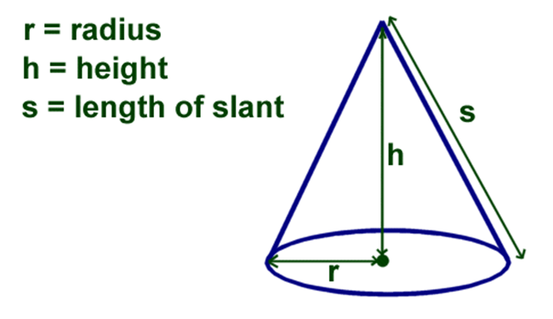
Problem: Cone Volume and Surface Area
Write a JS function to calculate cone volume and surface
The cone height h and radius of the base r are given
3
5
volume = 47.1239
area = 83.2298
3.3
7.8
volume = 88.9511
area = 122.0159
Formulas + online calculator: http://www.calculatorsoup.com/calculators/geometry-solids/cone.php

Slide 15
Solution: Cone Volume and Surface Area
Slant height
s = √(r² + h²)
Volume
V = π * r² * h / 3
Base surface area
B = π * r²
Lateral surface area
L = π * r * s
function cone(r, h) {
let s = Math.sqrt(r * r + h * h);
let volume = Math.PI * r * r * h / 3;
console.log("volume = " + volume);
let area = Math.PI * r * (r + s);
console.log("area = " + area);
}
Total surface area: A = B + L = π * r * (r + s)
Check your solution here: https://judge.softuni.bg/Contests/288

Slide 16
Statements in JS
Statements are "commands" to be executed
let number = 5;
console.log(number)
if (number === 5) {
number = number + 1
console.log(number)
}
;
Semicolon ; at the end of line is not mandatory in JS
Block { } statements hold a sequence of commands
Empty statement

Slide 17
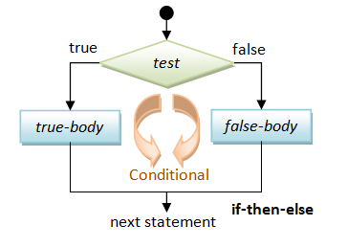
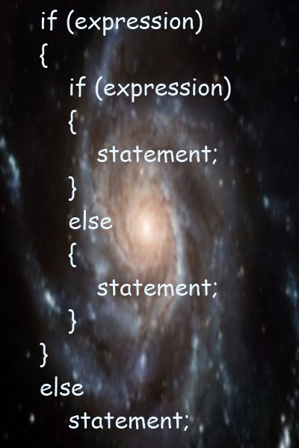
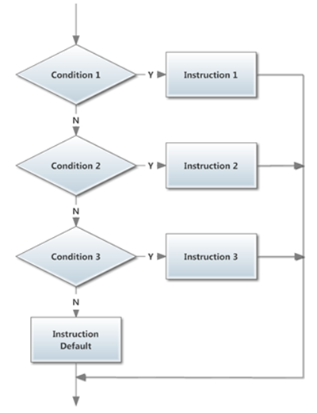
Conditional Statements
if-else, switch-case

Slide 18
Conditional Statements: if-else
JS supports the classical if / if-else statements:
let number = 5;
if (number % 2 === 0) {
console.log("Even number");
} else {
console.log("Odd number");
}

Slide 19
Problem: Odd / Even
Write a JS function to check if a number is odd or even or invalid
function oddEven(num) {
if (!Number.isInteger(num))
console.log("invalid")
else if (num % 2 === 0)
console.log("even")
else
console.log("odd")
}
5
odd
8
even
-3
odd
1.5
invalid
0
even
Check your solution here: https://judge.softuni.bg/Contests/288

Slide 20


Truthy and Falsy Expressions in JavaScript
JavaScript is rich of unexpected (for some people) behavior
console.log("0" == true) // false
console.log("0" == false) // true
if ("0") console.log(true) // true
console.log([] == true) // false
console.log([] == false) // true
if ([]) console.log(true); // true
console.log(null == false || null == true) // false
if (!null) console.log(true); // true
Have more fun at WTF JS: http://brian.io/slides/dotjs-2012/

Slide 21
The switch-case Statement
Selects for execution a statement from a list depending on the value of the switch expression
let day = 3
switch (day) {
case 1: console.log('Monday'); break;
case 2: console.log('Tuesday'); break;
case 3: console.log('Wednesday'); break;
…
case 7: console.log('Sunday'); break;
default: console.log('Error!'); break;
}

Slide 22
Problem: Fruit or Vegetable
Write a JS function to print "fruit", "vegetable" or "unknown" depending on the input string
Fruits are: banana, apple, kiwi, cherry, lemon, grapes, peach
Vegetable are: tomato, cucumber, pepper, onion, garlic, parsley
All others are unknown
lemon
fruit
peach
fruit
onion
vegetable
pizza
unknown

Slide 23
Solution: Fruit or Vegetable
function food(word) {
switch (word) {
case 'banana':
case 'apple':
case 'kiwi':
case 'cherry':
case 'lemon':
case 'grapes':
case 'peach':
console.log('fruit');
break;
case 'tomato':
case 'cucumber':
case 'pepper':
case 'onion':
case 'parsley':
case 'garlic':
console.log('vegetable');
break;
default:
console.log('unknown');
}
}
Check your solution here: https://judge.softuni.bg/Contests/288

Slide 24
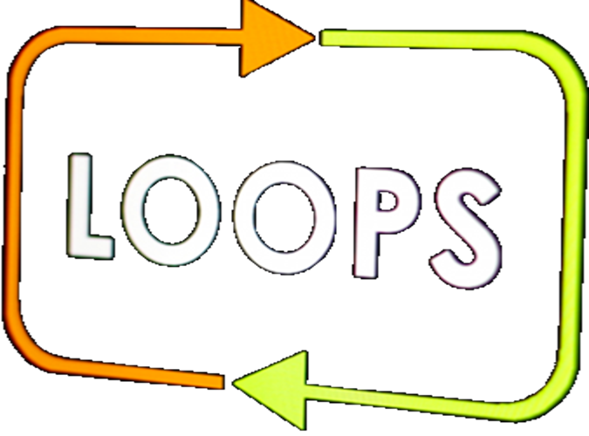
Loops in JS
for, while, do-while

Slide 25
Loops: for
The for / while / do-while loops work as in C++, C# and Java
Classical for-loop
for (let i = 0; i <= 5; i++)
console.log(i)
// 0 1 2 3 4 5
for (let i = 50; i >= 10; i -= 10)
console.log(i)
// 50 40 30 20 10

Slide 26
Loops: while, do-while, …
let count = 1
while (count < 1024)
console.log(count *= 2)
// 2 4 8 16 32 64 128 256 512 1024
let s = "ho"
do {
console.log(s);
s = s + s;
}
while (s.length < 20)
// ho hoho hohohoho hohohohohohohoho

Slide 27
Problem: Colorful Numbers 1 … n
Write a JS function to print the numbers from 1 to n
Return a string holding HTML list <ul><li>…</li></ul>
Display the odd lines in green, even lines in blue
<ul>
<li><span style='color:green'>1</span></li>
<li><span style='color:blue'>2</span></li>
<li><span style='color:green'>3</span></li>
…
</ul>

Slide 28
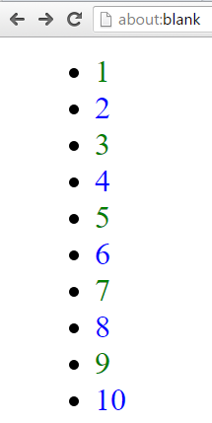
Solution: Colorful Numbers 1 … n
function nums(n) {
let html = '<ul>\n';
for (let i = 1; i <= n; i++) {
let color = 'blue';
if (i % 2 !== 0) color = 'green';
html += ` <li><span style='color: ${color}'>${i}</span></li>\n`;
}
html += '</ul>';
return html;
}
document.body.innerHTML = nums(10)
Check your solution here: https://judge.softuni.bg/Contests/288

Slide 29

Practice: Operators, Expressions, Conditional Statements, Loops
Live Exercises in Class (Lab)

Slide 30


Problem: Chessboard
Write a JS function to print a chessboard of size n. Examples:
<div class="chessboard">
<div>
<span class="black"></span>
<span class="white"></span>
</div>
<div>
<span class="white"></span>
<span class="black"></span>
</div>
<div>…</div>
</div>
n = 3
n = 4

Slide 31
Solution: Chessboard
function chessboard(size) {
let html = '<div class="chessboard">\n';
for (let row = 0; row < size; row++) {
html += ' <div>\n';
let color = (row % 2 === 0) ? 'black' : 'white';
for (let col = 0; col < size; col++) {
html += ` <span class="${color}"></span>\n`;
color = (color === 'white') ? 'black' : 'white';
}
html += ' </div>\n';
}
return html + '</div>';
}
Check your solution here: https://judge.softuni.bg/Contests/288

Slide 32
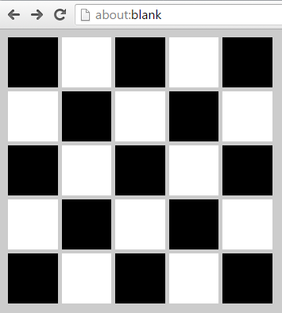
Chessboard: Visualization in the Browser
let css = document.createElement("style");
css.innerHTML = `
body { background: #CCC; }
.chessboard { display: inline-block; }
.black, .white {
width:50px; height:50px;
display: inline-block; }
.black { background: black; }
.white { background: white; }
`;
document.getElementsByTagName("head")[0].appendChild(css);
document.body.innerHTML = chessboard(5);

Slide 33
For Each Loop
for … in loop
for … of loop
let nums = [5, 10, 15, 20, 'maria', true];
for (let index in nums)
console.log(index);
// 0 1 2 3 4 5 → loops through the indices (keys), not values
let nums = [5, 10, 15, 20, 'maria', true];
for (let value of nums)
console.log(value);
// 5 10 15 20 maria true → loops through the values

Slide 34
Problem: Binary Logarithm
Write a JS function to enter n numbers and print for each number x its binary logarithm (log₂ x)
function binaryLogarithm(nums) {
for (let x of nums) {
console.log(Math.log2(x));
}
}
1024
1048576
256
1
2
10
20
8
0
1
Check your solution here: https://judge.softuni.bg/Contests/288

Slide 35
Problem: Prime Number Checker
function isPrime(num) {
let prime = true;
for (let d = 2; d <
Math.sqrt(num); d++) {
if (num % d === 0) {
prime = false;
break;
}
}
return prime && (num > 1);
}
break exits the innermost loop
Check your solution here: https://judge.softuni.bg/Contests/288

Slide 36
Continue
continue goes to the next loop iteration
Skips the lines to the end of loop body
for (let x = 0; x < 10; x++) {
if (x % 2 === 0)
continue;
console.log(x++);
}
// Prints 1 3 5 7 9

Slide 37

Summary
Operators and expressions in JS are similar to C# / Java / PHP / C++, but not identical
|| returns the leftmost "true" expression
Conditional statements in JS are like in all modern programming languages:
Classical conditionals: if-else, switch-case
Loops in JavaScript
Classical loops: while, do-while, for loops
Iterate over collection: for … in and for … of

Slide 38








Control-Flow Logic in JS
https://softuni.bg/courses/

Slide 39
License
This course (slides, examples, demos, videos, homework, etc.) is licensed under the "Creative Commons Attribution-NonCommercial-ShareAlike 4.0 International" license

Slide 40





Free Trainings @ Software University
Software University Foundation – softuni.org
Software University – High-Quality Education, Profession and Job for Software Developers
softuni.bg
Software University @ Facebook
facebook.com/SoftwareUniversity
Software University Forums
forum.softuni.bg

